Slide 1

KL Deemed to be a UNIVERSITY
DEPARTMENT OF ECE
Pollution Detector Using MQ Sensor
Name of the Student Register No. Section Research Group/Batch.No
D.Indu 150040209 13 7
K.Harish 150040381 13 7
G.Ajith 150040253 14 7
G.Chethan 150040 9 7
Name of the Supervisor: K.Sripath Roy
Designation/Department: Asst.Professor
Research Group: Open Source

Slide 2
OVERVIEW OF THE PRESENTATION
Introduction
Objectives of the Project
Motivation for the Project
Literature Review
Problem Identified
Methods/Methodology
Advantages & Limitations
Discussion on Results of the base paper
Contribution to the society
Future enhancement

Slide 3
INTRODUCTION
Let us own the rise of protecting the environment with the help of technology. Many evolutions had taken place in the technology till now, let us now add a smart feature to the existing technology to help our society.
We have ample kinds of implementation of IoT devices have potential to transform in various ways of daily life. For applicants, ingenious IoT products are just like home automation devices, Internet-enabled gadgets, and energy management devices etc.,

Slide 4
OBJECTIVES OF THE PROJECT WORK
The main motto of this project is to reduce vehicular pollution by using IoT.
We will divert the traffic to the shortest path using IoT on the basis of high pollution in the opted route
This mechanism can be used in various scenarios and significant effectiveness is produced using this project.
To implement the pollution detector we require MQ135 sensor, ARDUINO, GSM module.

Slide 5
MOTIVATION FOR THE PROJECT
These will lead all the humans towards an idea of the smart cities, presenting even more security with energy efficacy for daily life.
We often observe traffic jam and high pollution on roads. Presently we are using Google Maps app on our mobile phones to get rid of this problem.
So, using the MQ135 sensor along with an interface of GSM(Global System for Mobile) will detect the harmful gases when high in air and will send a message to the mobile, such that we find the other path to travel.

Slide 6
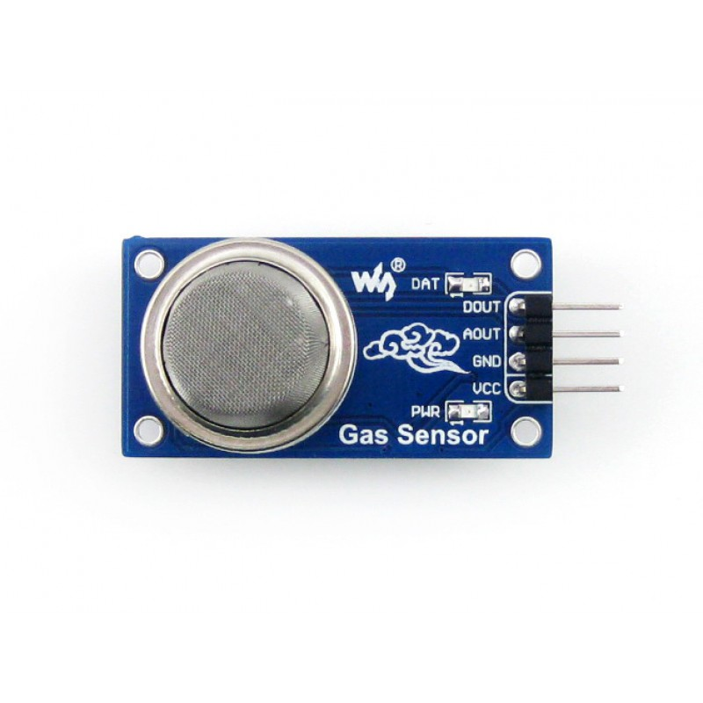
MQ135
They are used in air quality control equipments
FEATURES:
1) Wide detecting scope
2)Fast response and High sensitivity
3)Stable and long life
4)Simple drive circuit

Slide 7
GSM 900
GSM – Global System for Mobile
A GSM modem is a device which can act as either a mobile phone or a modem, which can be used to make a computer or any other processor to communicate over a network.
The GSM modem has wide range of applications in transaction terminals, supply chain management, security applications, weather stations and GPRS mode remote data logging.

Slide 8
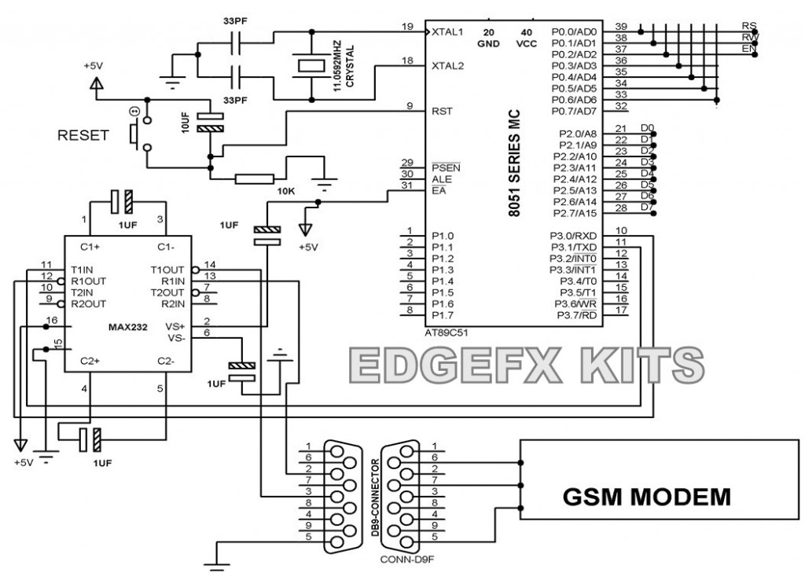
Block Diagram Of GSM900

Slide 9
DISCUSSION ON RESULTS OF THE BASE PAPER

Slide 10
CONTRIBUTION TO THE SOCIETY
AND
FUTURE ENHANCEMENT
In order to decrease pollution we have to detect the places where high pollution is observed.
So we are considering this problem and would like to find a solution to this problem.

Slide 11
THANK YOU

